Slide 1
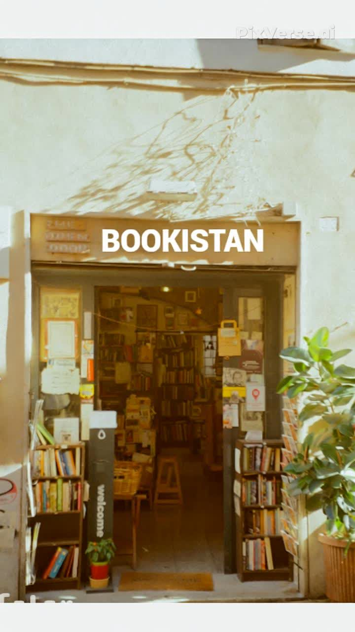
BOOKISTAN
Presented by
Abdul-Ahad
M. Asad
Abdul-Rafay
Alishwa-Rizwan
Mehreen

Slide 2
PROJECT OVERVIEW
Project Objectives and Vision
Bridging Physical & Digital
Enhanced User Experience
Technical Proficiency
This project served as a practical application of our web development skills, demonstrating proficiency in front-end design, data handling, and deployment best practices.
Our primary aim was to create an intuitive and aesthetically pleasing online bookstore. We sought to replicate the charm of a physical bookshop in a digital format, making book discovery and purchasing seamless.
We focused on delivering a user-centric design, ensuring easy navigation, responsive layouts, and rich content to engage bibliophiles and casual readers alike.

Slide 3
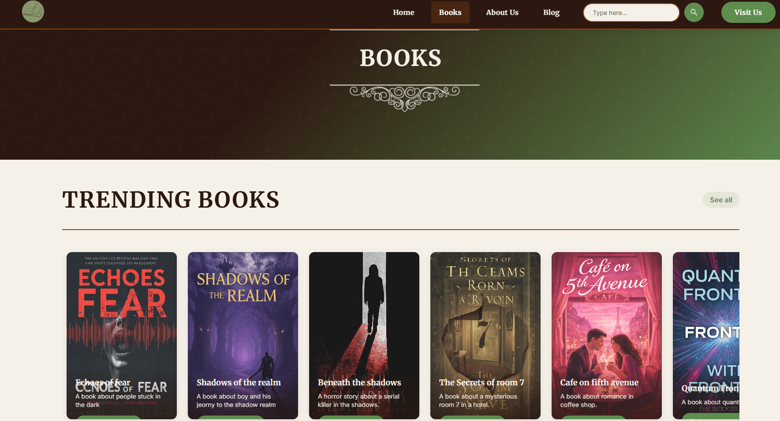
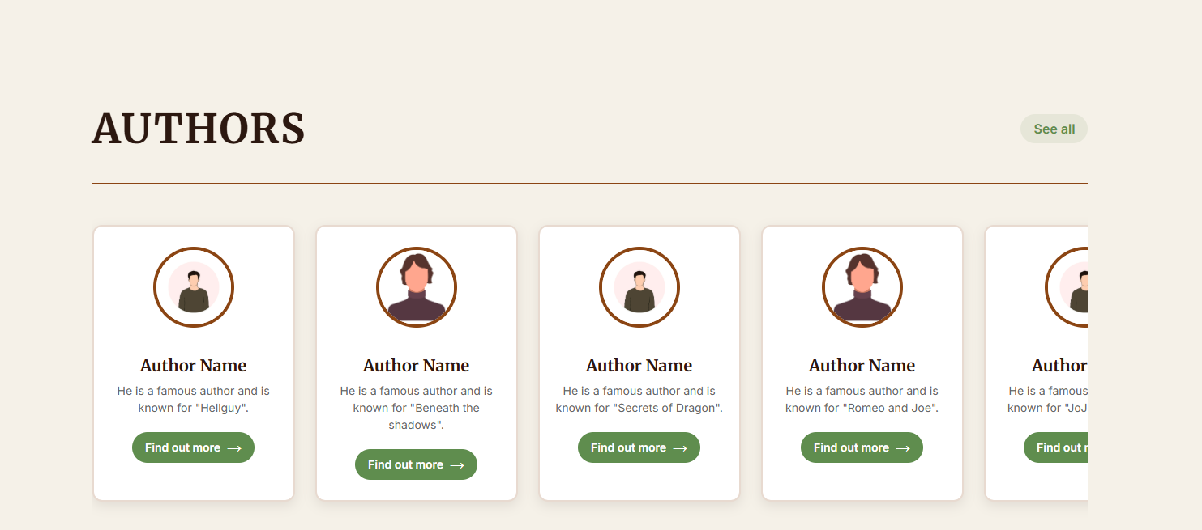
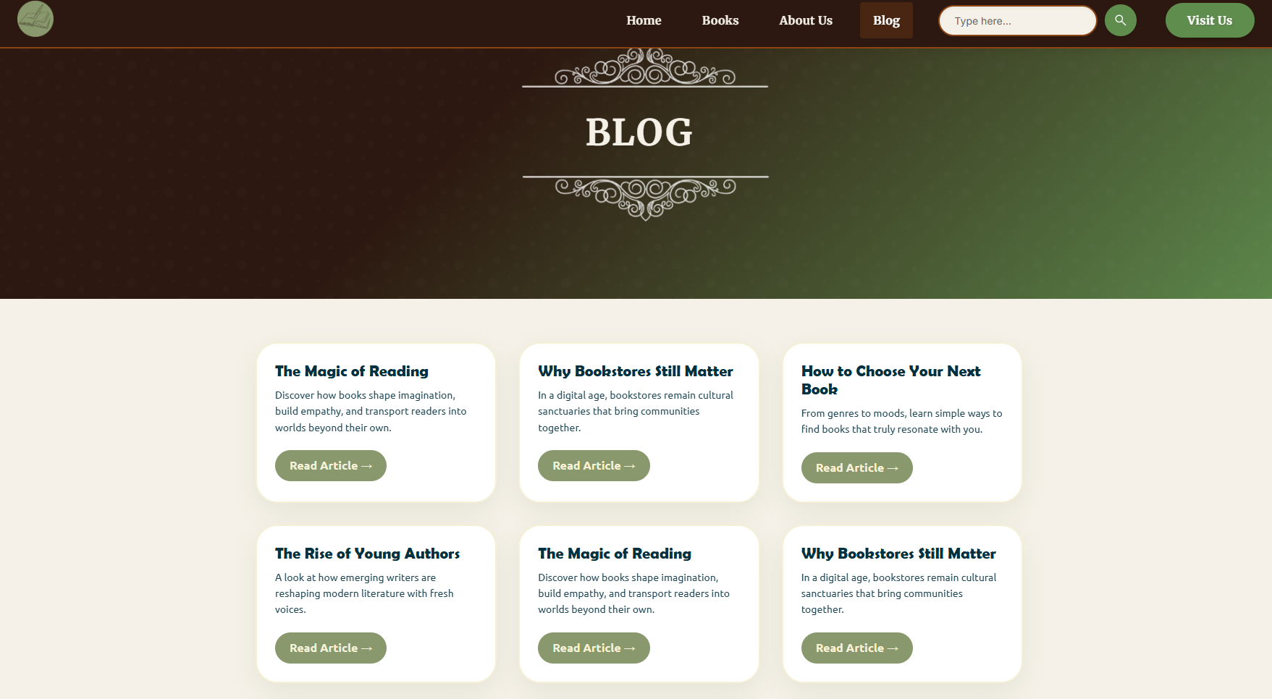
WEBSITE WALKTHROUGH
A Glimpse into Our Digital Bookstore
Explore the foundational pages of our website, meticulously designed for clarity and visual appeal.

Slide 4
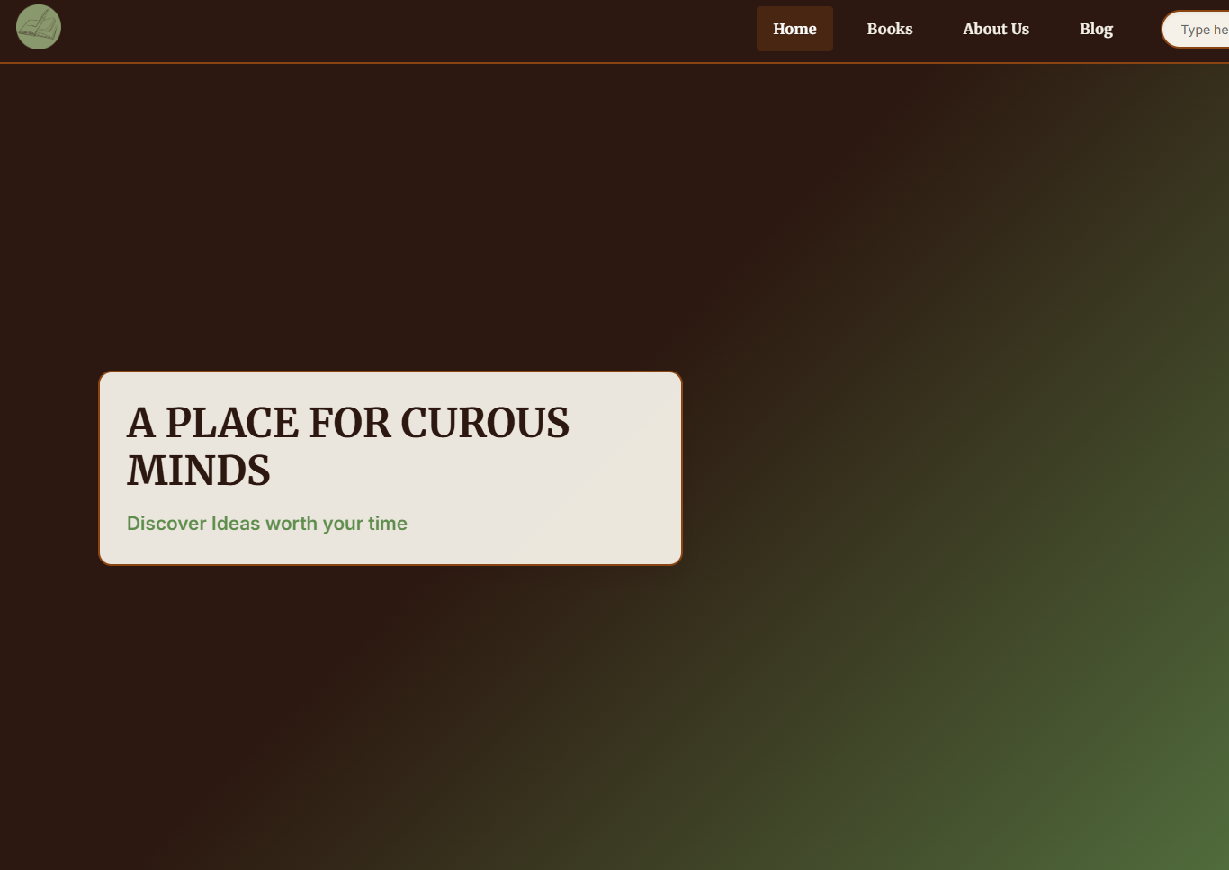
Homepage: Your Gateway to New Worlds
The homepage offers a warm welcome, showcasing new arrivals and bestsellers. Its clean layout guides users effortlessly to their next literary adventure.

Slide 5
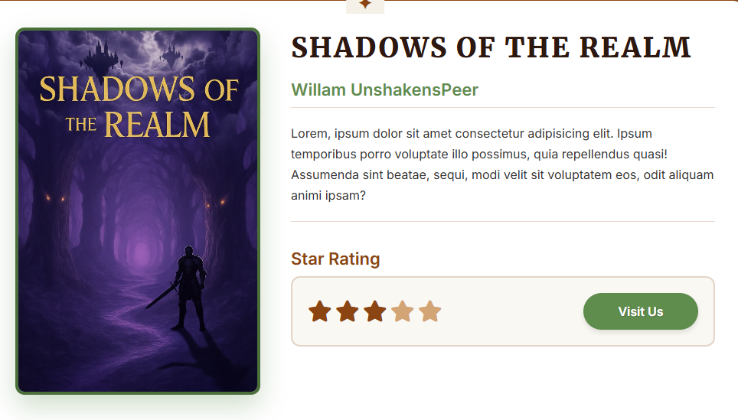
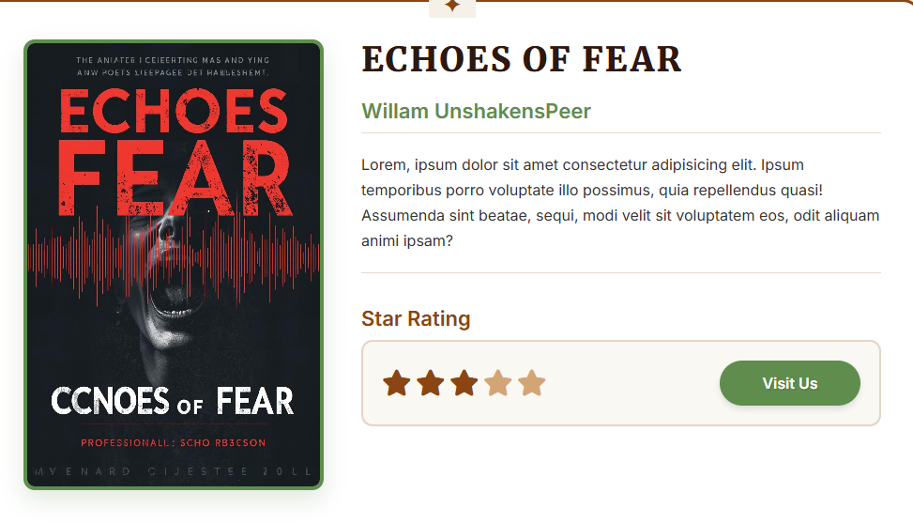
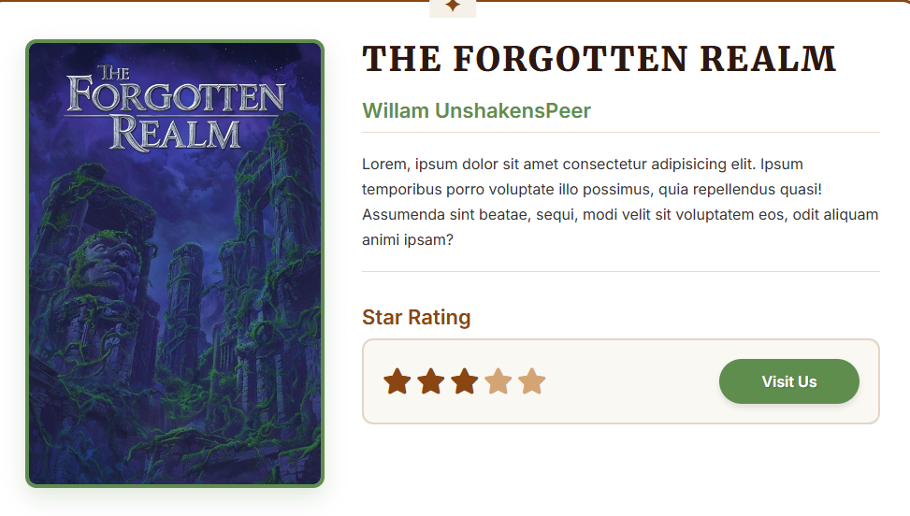
Product Page: Dive Deeper into Every Story
Each product page provides comprehensive details: captivating summaries, author information, customer reviews, and clear purchasing options, encouraging informed decisions.

Slide 6
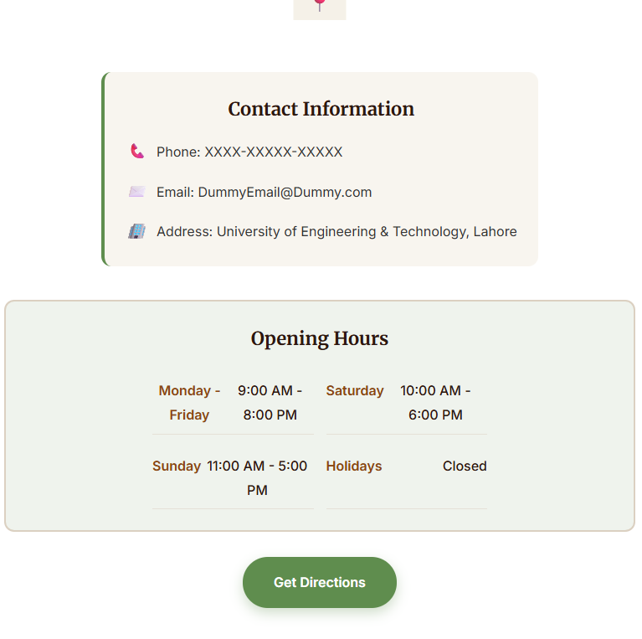
Contact Page: Connect with Us
Our contact page ensures customers can easily reach out. It features a straightforward form, essential contact information, and links to our social media, fostering community.

Slide 7
Analysing Book Sales Trends
Our backend data, managed efficiently with Excel, provides valuable insights into popular genres and sales performance.
This chart illustrates our top-selling categories.

Slide 8
DESIGN PHILOSOPHY
Intentional Choices for an Engaging Experience
Clean, Responsive Layouts
Intuitive Feature Placement
Warm & Inviting Colour Palette
Prioritising readability and accessibility, our layouts are clean, spacious, and fully responsive, adapting seamlessly across all devices.
Key features such as search bars, genre filters, and 'add to cart' buttons are strategically placed for maximum ease of use and efficiency.
We selected a palette of warm, earthy tones combined with subtle accents to create a cosy, inviting atmosphere reminiscent of a traditional library.

Slide 9
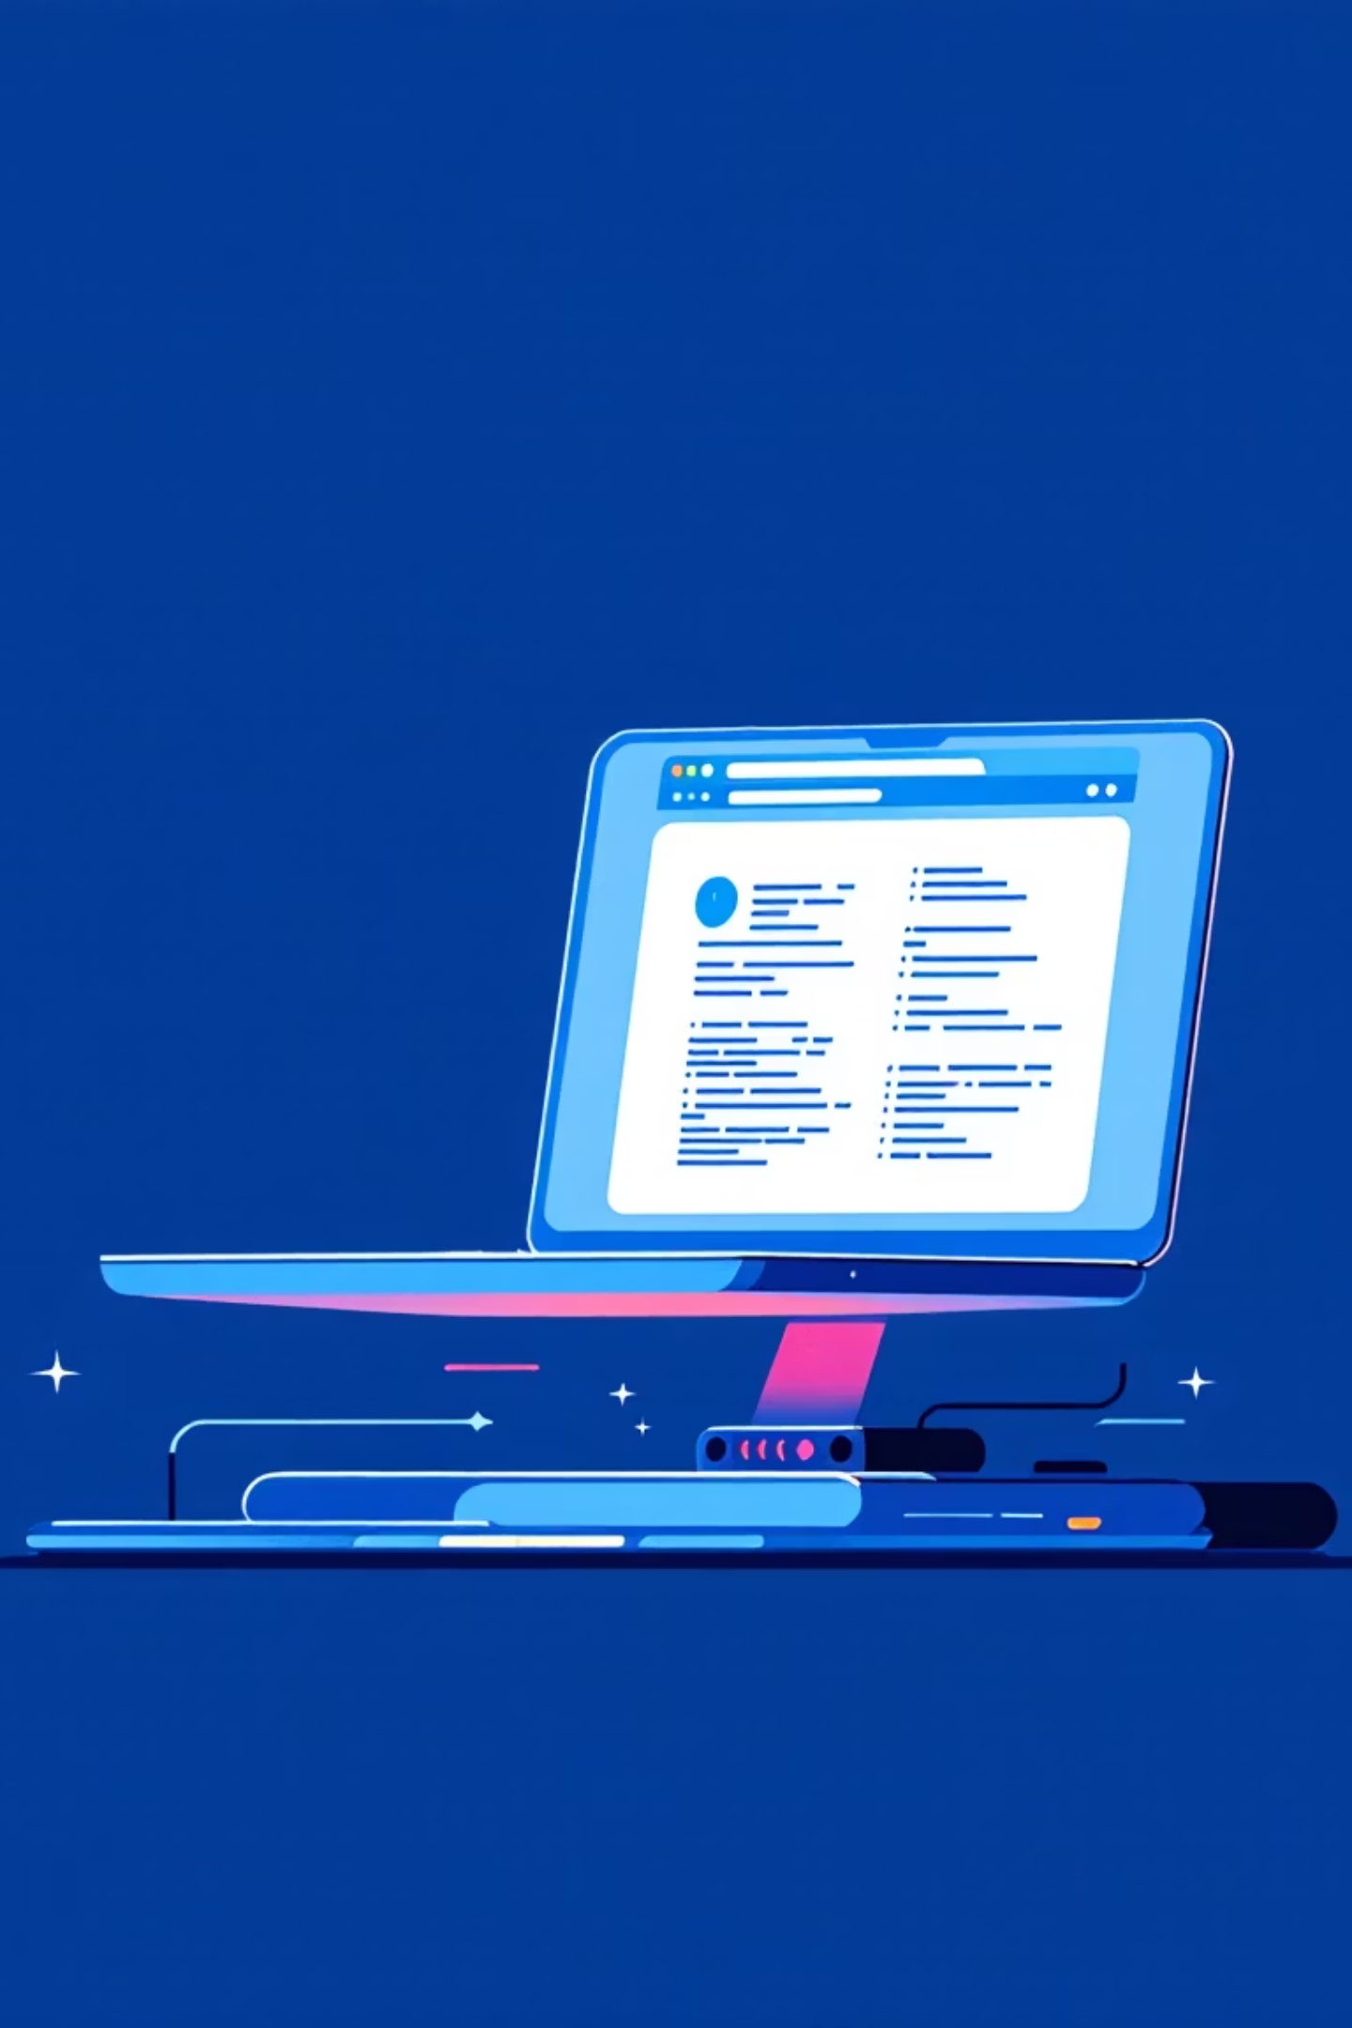
ACCESSING OUR WORK
Explore the Project Live
Live Demo
Source Code
Experience the online bookstore firsthand:
Development details:
https://github.com/AbdulRafay123981/GroupA-Bookstore.git
https://abdulrafay123981.github.io/GroupA-Bookstore/index.html

Slide 10

REFLECTIONS & FUTURE
Lessons Learned & Next Steps
1
What Went Well
Successful implementation of responsive design and a clean, intuitive user interface. Effective use of version control and collaborative tools.
2
Areas for Improvement
Integrating a more dynamic search functionality and exploring advanced filtering options based on user preferences.
3
Future Enhancements
Adding a user authentication system, personalised recommendations, and a more robust backend for inventory management.

Slide 11
Thank You for
Visiting Our
Store ;)

